Slide 1

Skill Barter Android APP
By Noa Binenbaum and Jenny Kapul
Guided by Hovav Gazit

Slide 2
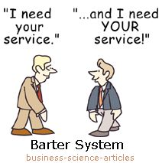

Slide 3
What for?
Skills and services exchange
!Money
No need in “favors”
Improve your skills and acquire new ones
Meet new people based on interests
Notes:
Create a new platform for skills and services exchange free of charge
Gain points by offering services based on your skills
Receive services in exchange for point gained
Supervise the quality of services offered by sustaining up to date ranking system
Eliminate completely the need of money exchange between users
Allows flexible and constantly adjustable schedule for services offered

Slide 4



How?
Native Java – Using Android Studio IDE
Firebase framework –
Authentication
Firestore – All app related data storage
UX/UI design – Intuitive interface with minimal hierarchy

Slide 5
Activities Flow Chart

Slide 6
Client - Server
Server Side
Registration
Authentication
Database
Client Side
Manage users’ data
Schedule appointments
Automated transactions on completion
Query and display:
Relevant available future appointments
Already scheduled appointments (future and history)

Slide 7
Database
Cloud Firestore is a cloud-hosted, NoSQL database
Data is stored in documents that contain fields mapping to values
Documents are stored in collections and are used for organizing data and building queries.
Some Documents have sub-collections
Documents support many different data types

Slide 8
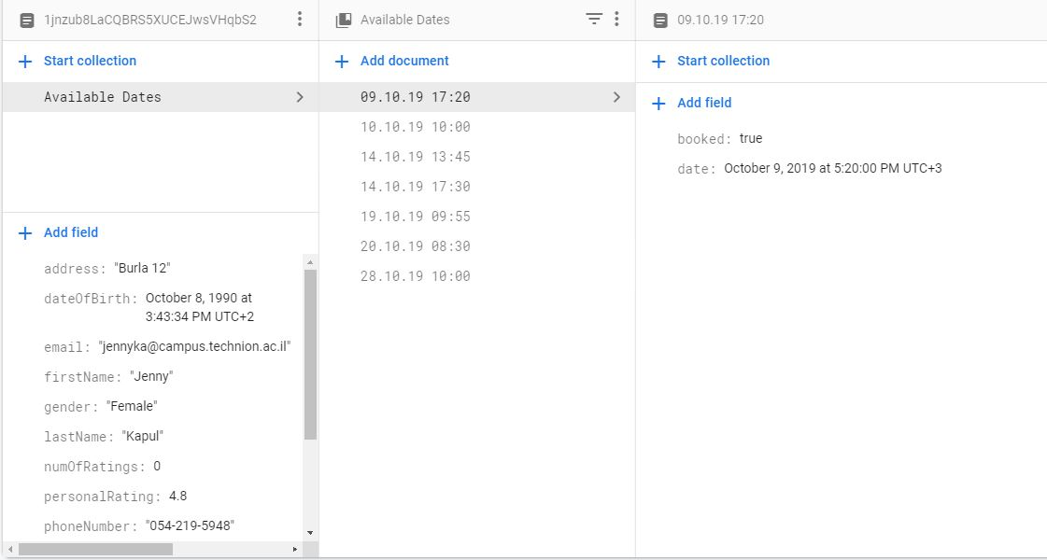
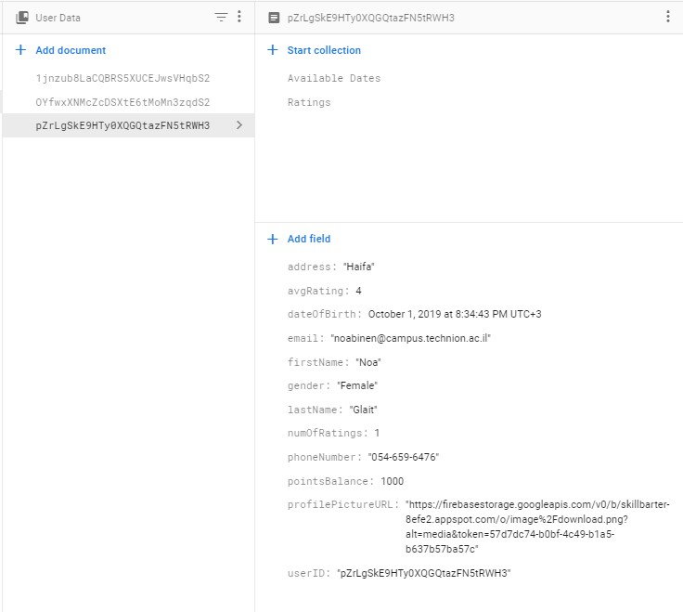
Database – User Data
e-mail address
Full name
Profile picture
Birthday
Phone number
Points Balance
Available Dates (sub-collection)
Booked (<boolean>)
Date (<timestamp>)
Raiting

Slide 9
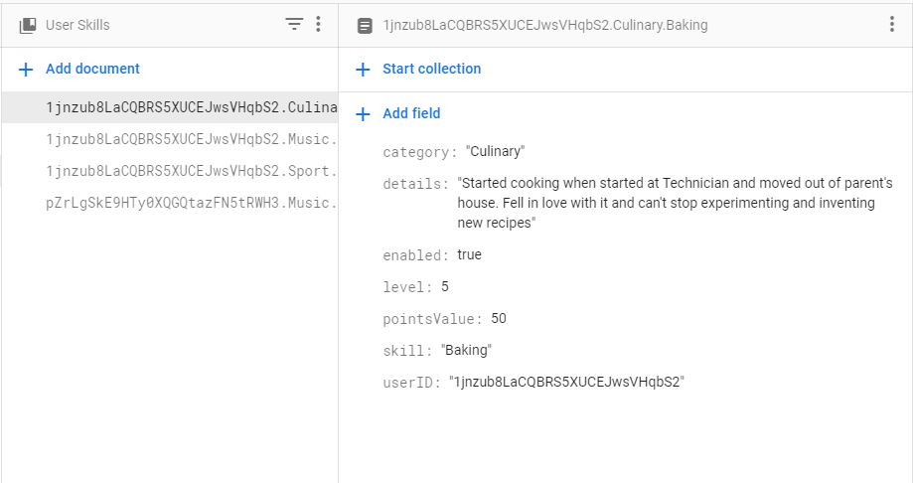
Database – User Skills
UserID
Category
Skill
Details
Enabled (<boolean>)
Points value
Level

Slide 10
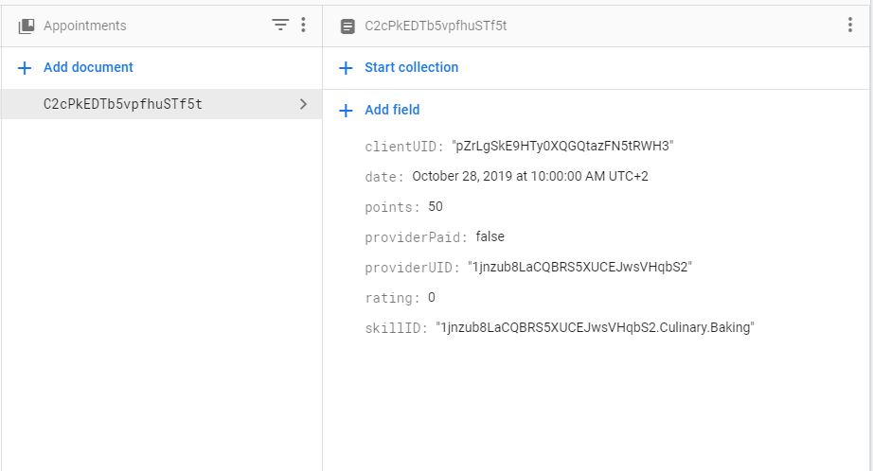
Database – Appointments
ProviderUID
ClientUID
SkillID
Date
Points
Provider Paid (<boolean>)
Rating

Slide 11
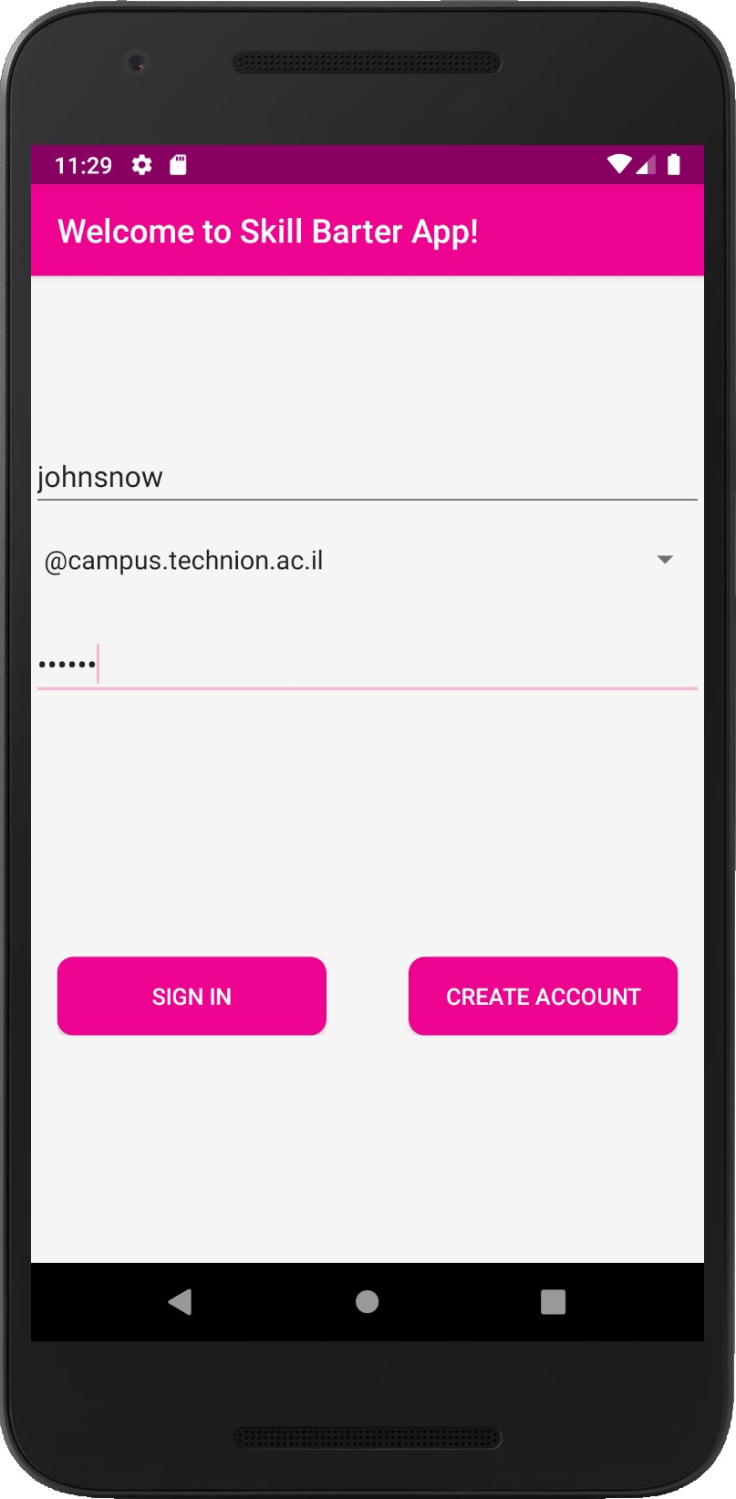
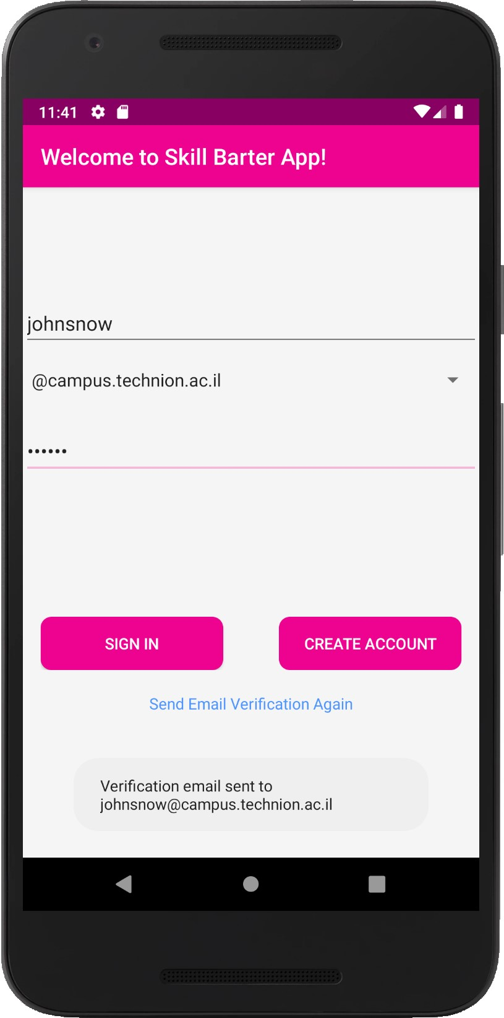
Features
Authentication
Sign in
Create account
Technion only
Notes:
Easy authentication integrating Facebook, Google, Tweeter accounts
Allow sign-up for Technion students only (by Technion e-mail verification)
Each user can constantly change and modify services offered by him and his interests
Set the location of offered services
Set for each service offered the amount of requested points per service unit
Advanced search with filters:
By field / location (static or dynamic) / ranking etc
Ranking and dispute resolution system to increase users satisfaction
The ranking is mutual – both the user offering the service and the user receiving one
Instant messaging system – for secure and easy interaction between users

Slide 12
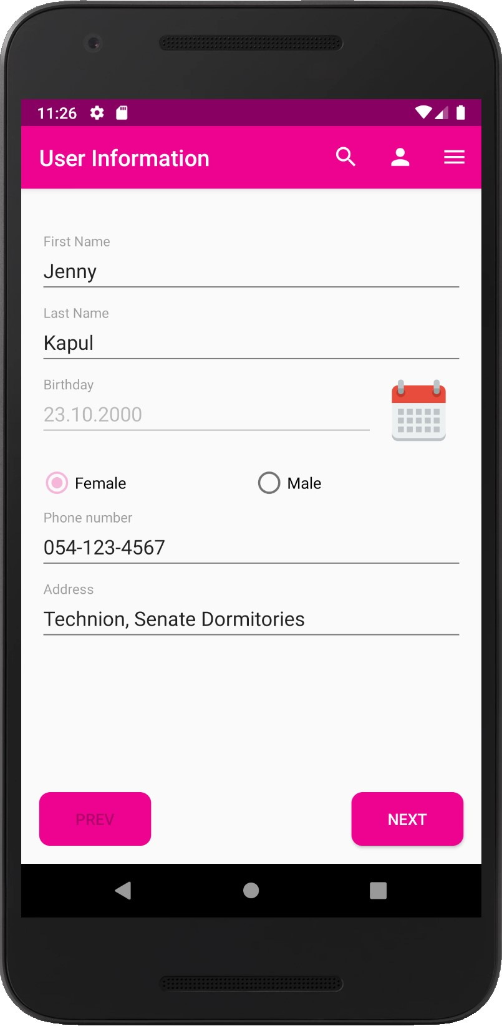
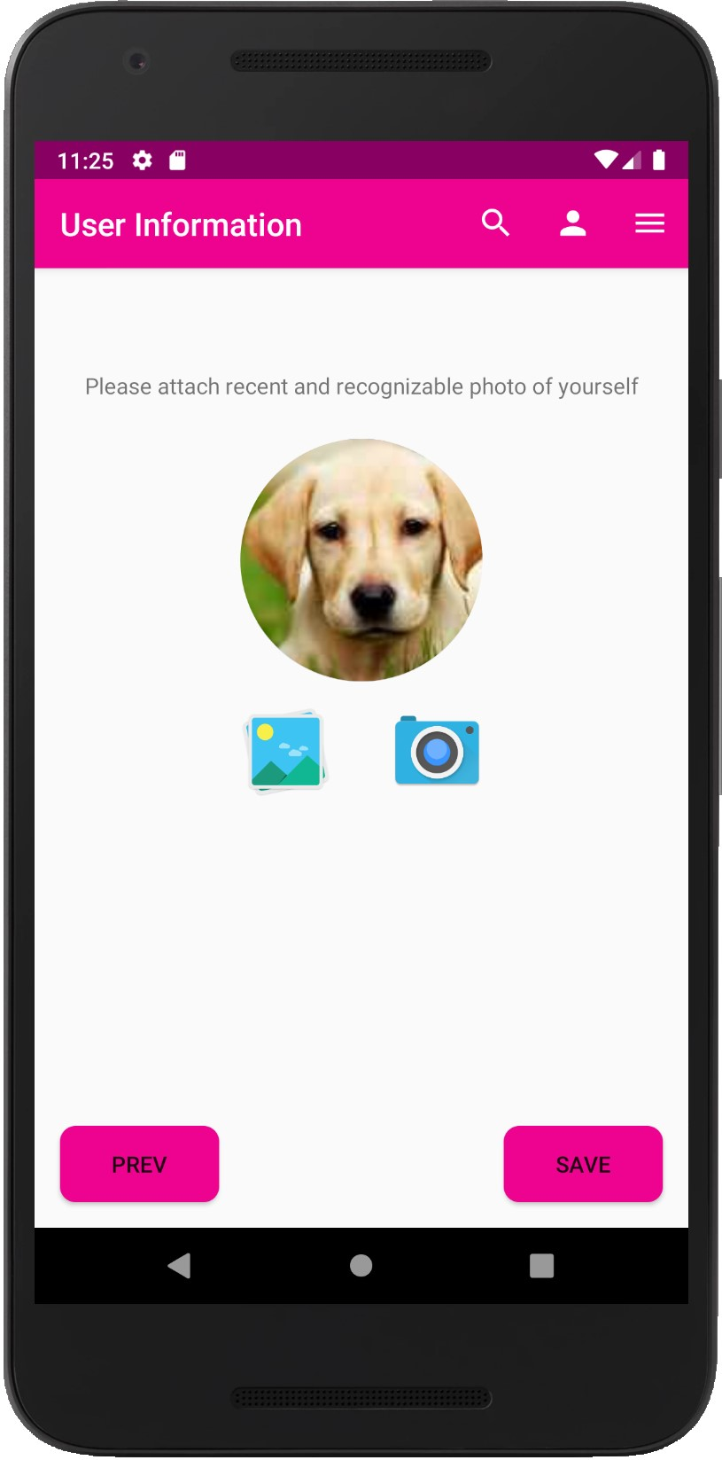
Features
Registration
Edit profile data
Notes:
Easy authentication integrating Facebook, Google, Tweeter accounts
Allow sign-up for Technion students only (by Technion e-mail verification)
Each user can constantly change and modify services offered by him and his interests
Set the location of offered services
Set for each service offered the amount of requested points per service unit
Advanced search with filters:
By field / location (static or dynamic) / ranking etc
Ranking and dispute resolution system to increase users satisfaction
The ranking is mutual – both the user offering the service and the user receiving one
Instant messaging system – for secure and easy interaction between users

Slide 13
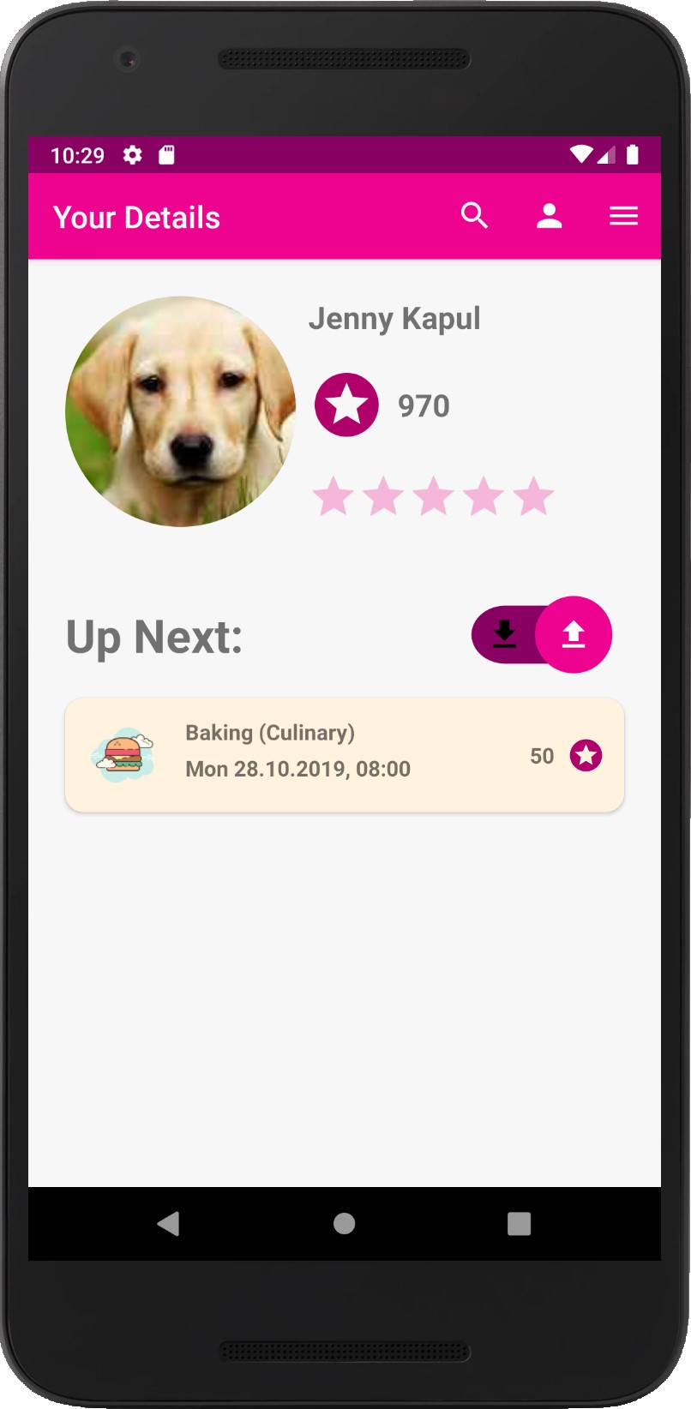
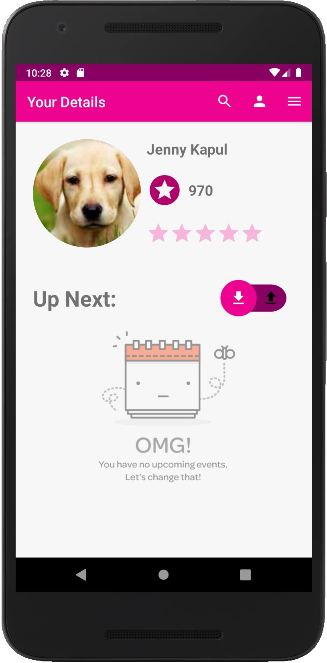
Features
Home Profile
Upcoming events
Notes:
Easy authentication integrating Facebook, Google, Tweeter accounts
Allow sign-up for Technion students only (by Technion e-mail verification)
Each user can constantly change and modify services offered by him and his interests
Set the location of offered services
Set for each service offered the amount of requested points per service unit
Advanced search with filters:
By field / location (static or dynamic) / ranking etc
Ranking and dispute resolution system to increase users satisfaction
The ranking is mutual – both the user offering the service and the user receiving one
Instant messaging system – for secure and easy interaction between users

Slide 14
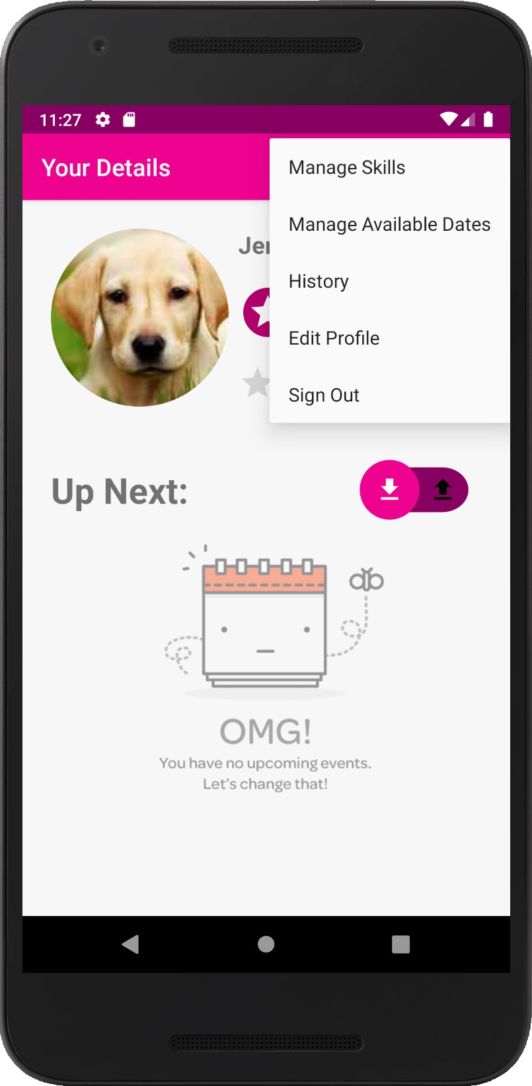
Features
Menu bar
Available from all major features for quick navigation
Notes:
Easy authentication integrating Facebook, Google, Tweeter accounts
Allow sign-up for Technion students only (by Technion e-mail verification)
Each user can constantly change and modify services offered by him and his interests
Set the location of offered services
Set for each service offered the amount of requested points per service unit
Advanced search with filters:
By field / location (static or dynamic) / ranking etc
Ranking and dispute resolution system to increase users satisfaction
The ranking is mutual – both the user offering the service and the user receiving one
Instant messaging system – for secure and easy interaction between users

Slide 15
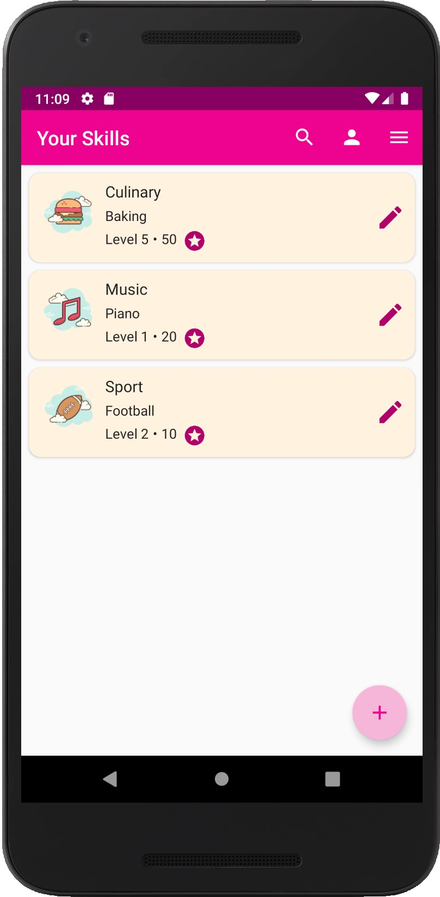

Features
Skill Manager
Add new skill
Notes:
Easy authentication integrating Facebook, Google, Tweeter accounts
Allow sign-up for Technion students only (by Technion e-mail verification)
Each user can constantly change and modify services offered by him and his interests
Set the location of offered services
Set for each service offered the amount of requested points per service unit
Advanced search with filters:
By field / location (static or dynamic) / ranking etc
Ranking and dispute resolution system to increase users satisfaction
The ranking is mutual – both the user offering the service and the user receiving one
Instant messaging system – for secure and easy interaction between users

Slide 16
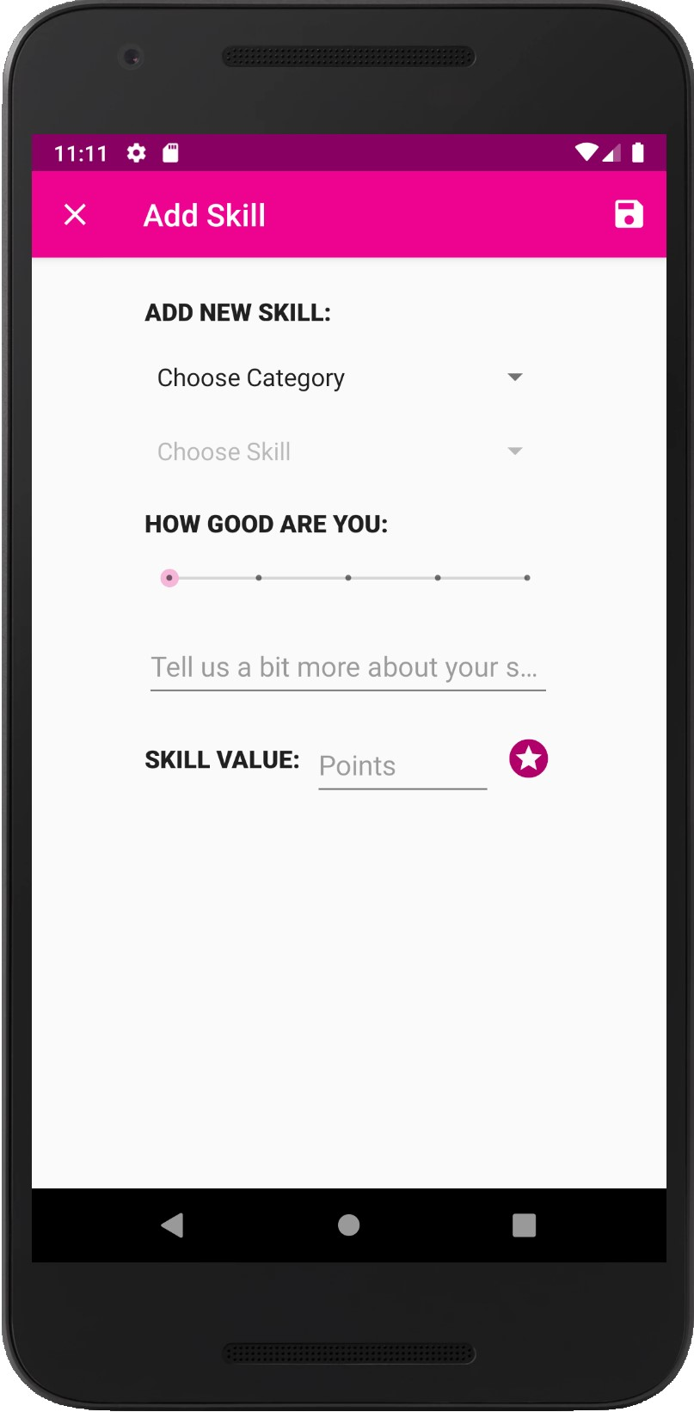
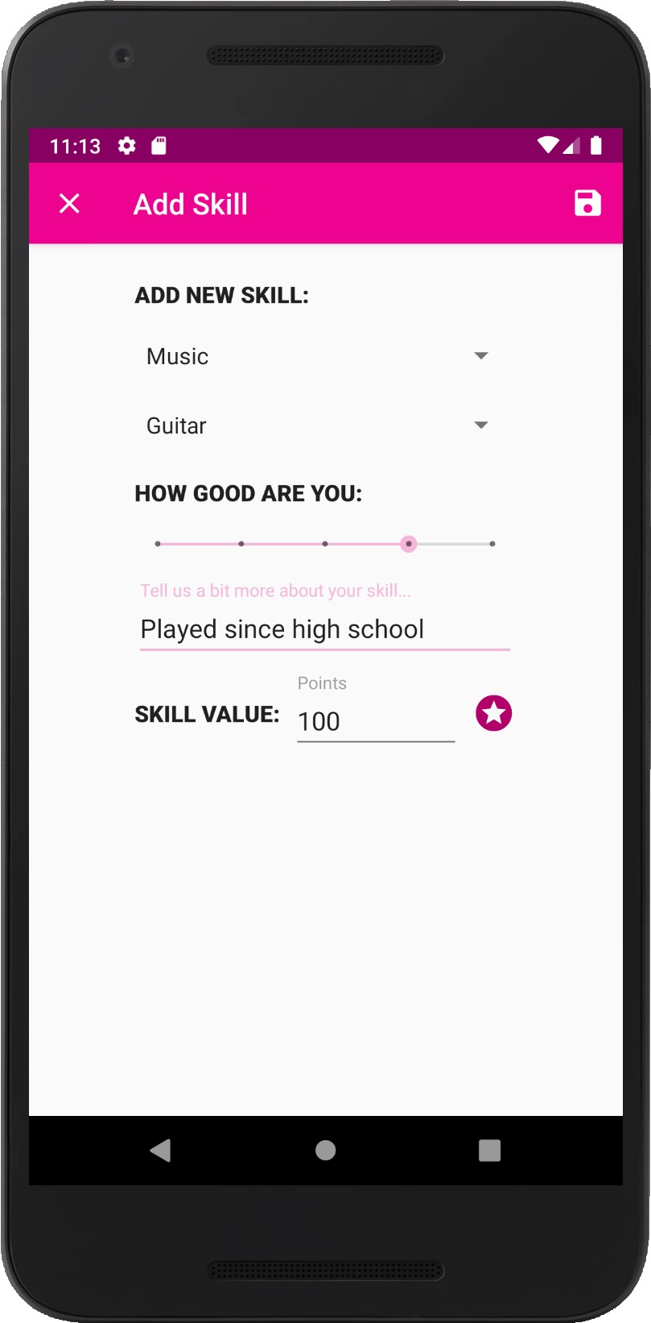
Features
Skill Manager
Add new skill
Notes:
Easy authentication integrating Facebook, Google, Tweeter accounts
Allow sign-up for Technion students only (by Technion e-mail verification)
Each user can constantly change and modify services offered by him and his interests
Set the location of offered services
Set for each service offered the amount of requested points per service unit
Advanced search with filters:
By field / location (static or dynamic) / ranking etc
Ranking and dispute resolution system to increase users satisfaction
The ranking is mutual – both the user offering the service and the user receiving one
Instant messaging system – for secure and easy interaction between users

Slide 17
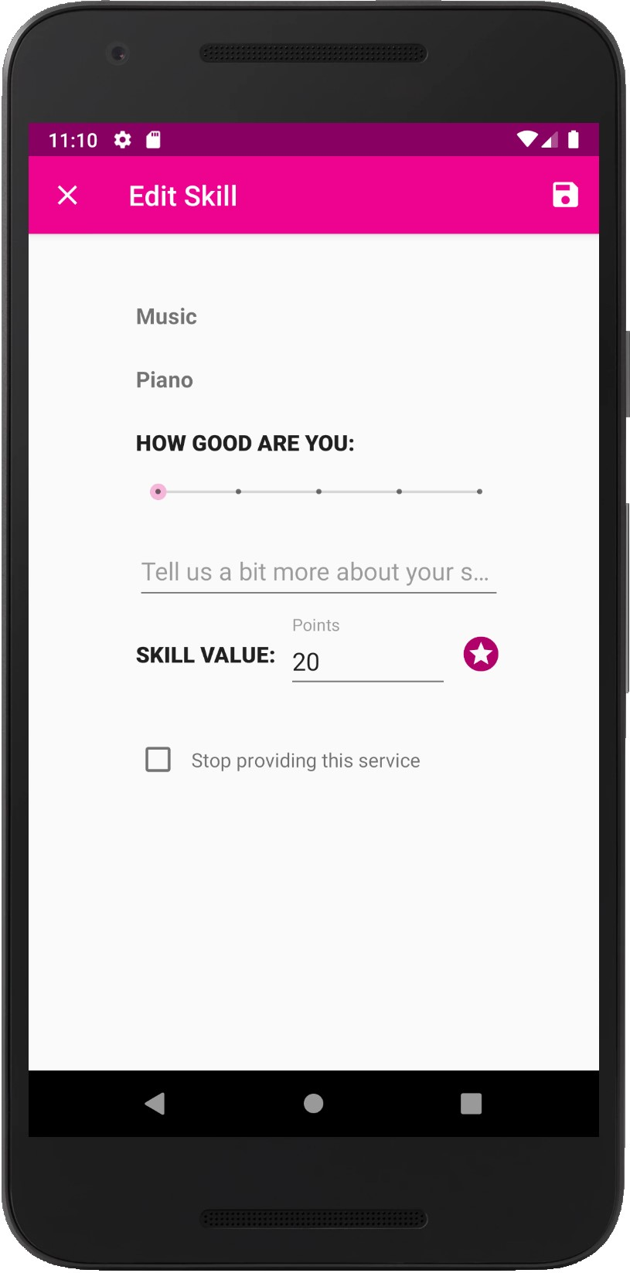
Features
Skill Manager
Add new skill
Edit existing
Disable skill
Notes:
Easy authentication integrating Facebook, Google, Tweeter accounts
Allow sign-up for Technion students only (by Technion e-mail verification)
Each user can constantly change and modify services offered by him and his interests
Set the location of offered services
Set for each service offered the amount of requested points per service unit
Advanced search with filters:
By field / location (static or dynamic) / ranking etc
Ranking and dispute resolution system to increase users satisfaction
The ranking is mutual – both the user offering the service and the user receiving one
Instant messaging system – for secure and easy interaction between users

Slide 18
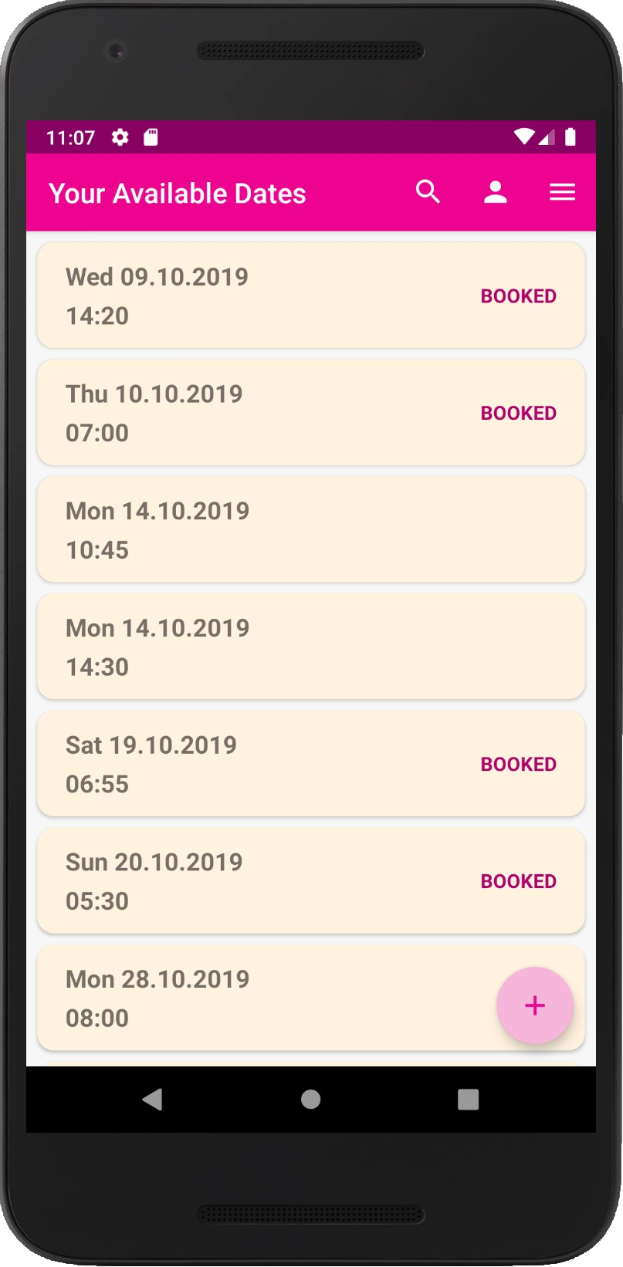
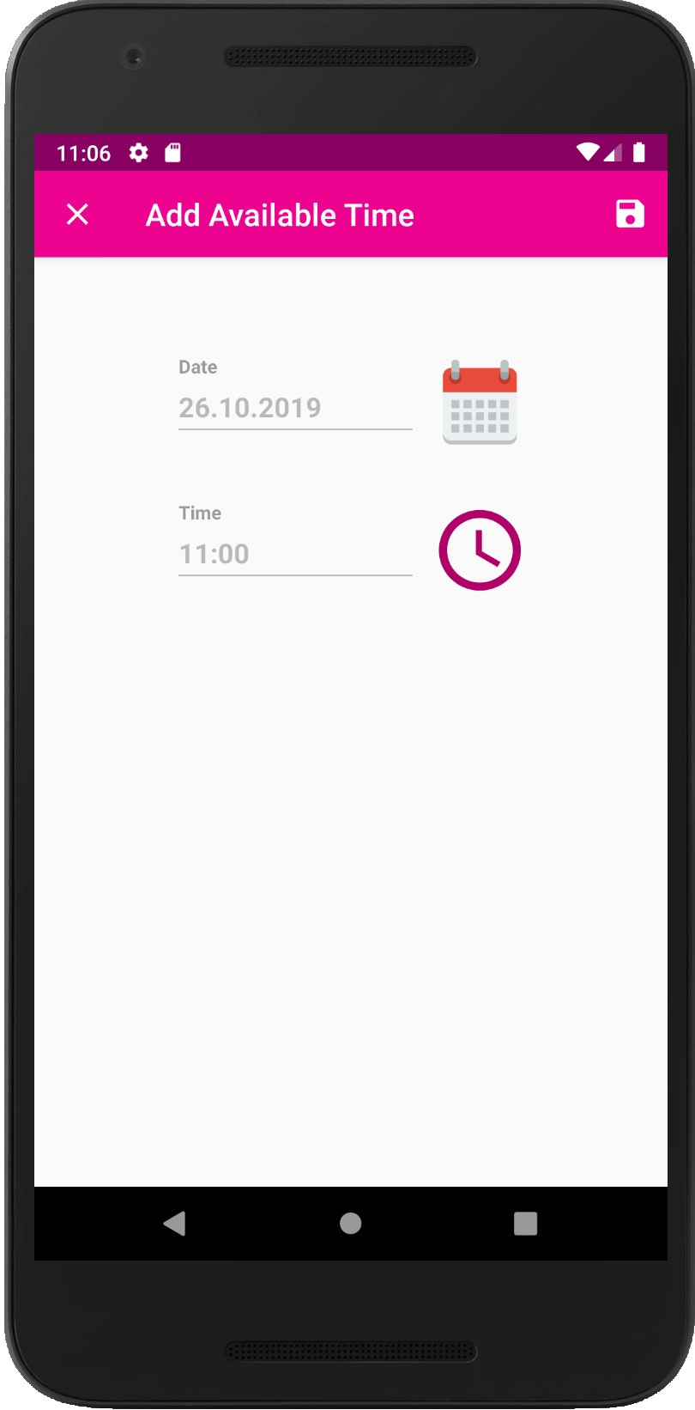
Features
Manage Available Dates
Notes:
Easy authentication integrating Facebook, Google, Tweeter accounts
Allow sign-up for Technion students only (by Technion e-mail verification)
Each user can constantly change and modify services offered by him and his interests
Set the location of offered services
Set for each service offered the amount of requested points per service unit
Advanced search with filters:
By field / location (static or dynamic) / ranking etc
Ranking and dispute resolution system to increase users satisfaction
The ranking is mutual – both the user offering the service and the user receiving one
Instant messaging system – for secure and easy interaction between users

Slide 19
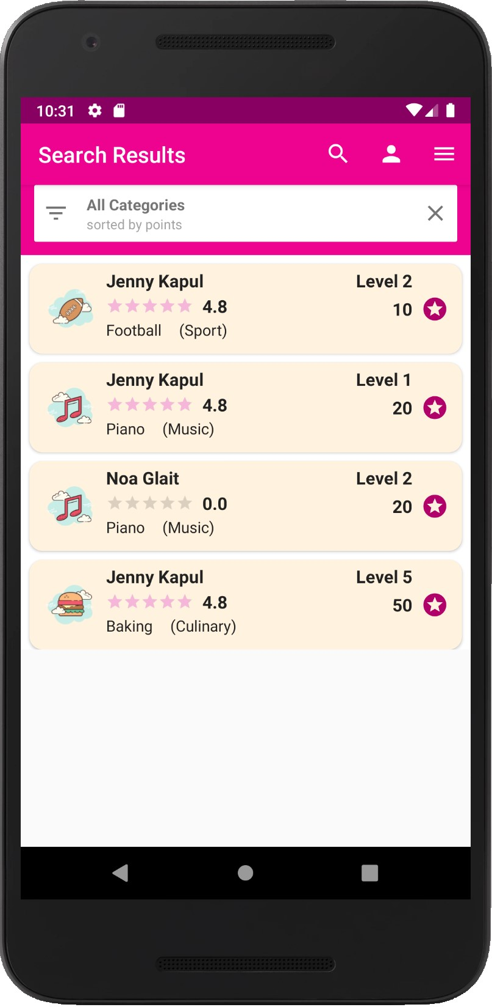
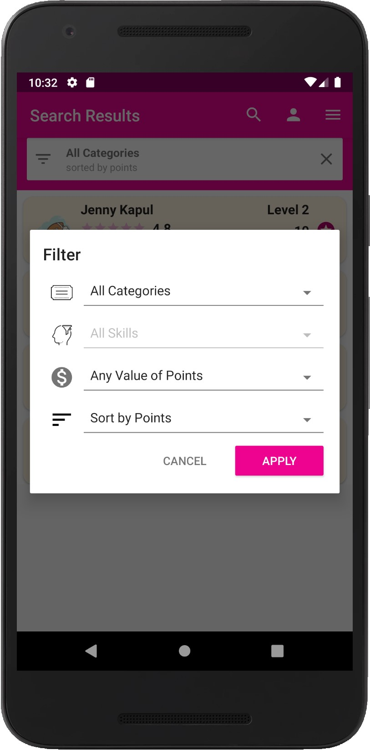
Features
History
Define filters
Sort results
Notes:
Easy authentication integrating Facebook, Google, Tweeter accounts
Allow sign-up for Technion students only (by Technion e-mail verification)
Each user can constantly change and modify services offered by him and his interests
Set the location of offered services
Set for each service offered the amount of requested points per service unit
Advanced search with filters:
By field / location (static or dynamic) / ranking etc
Ranking and dispute resolution system to increase users satisfaction
The ranking is mutual – both the user offering the service and the user receiving one
Instant messaging system – for secure and easy interaction between users

Slide 20
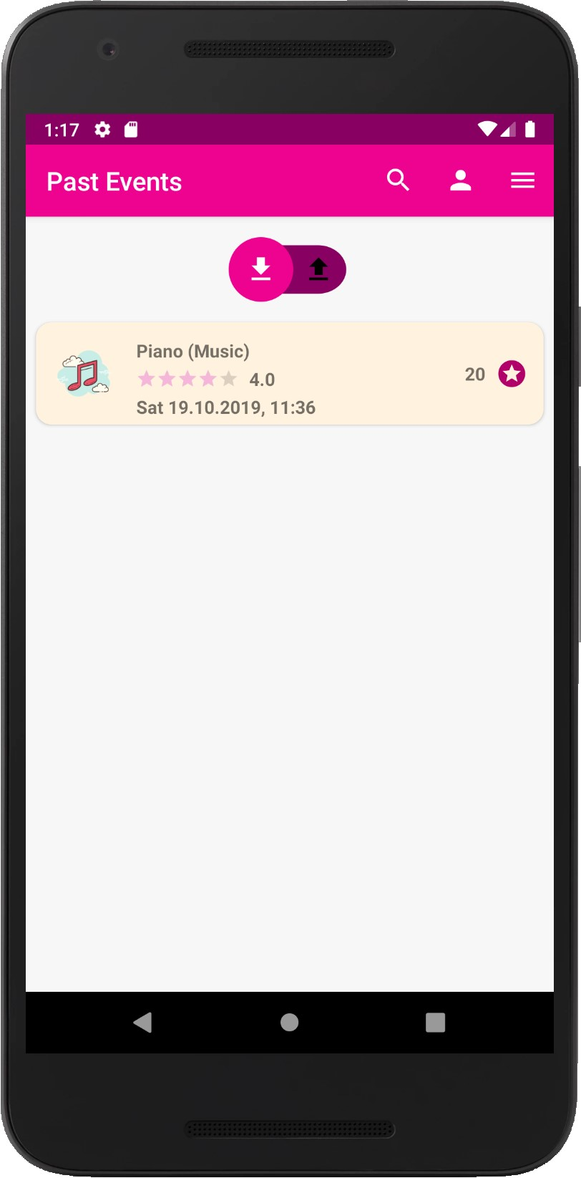
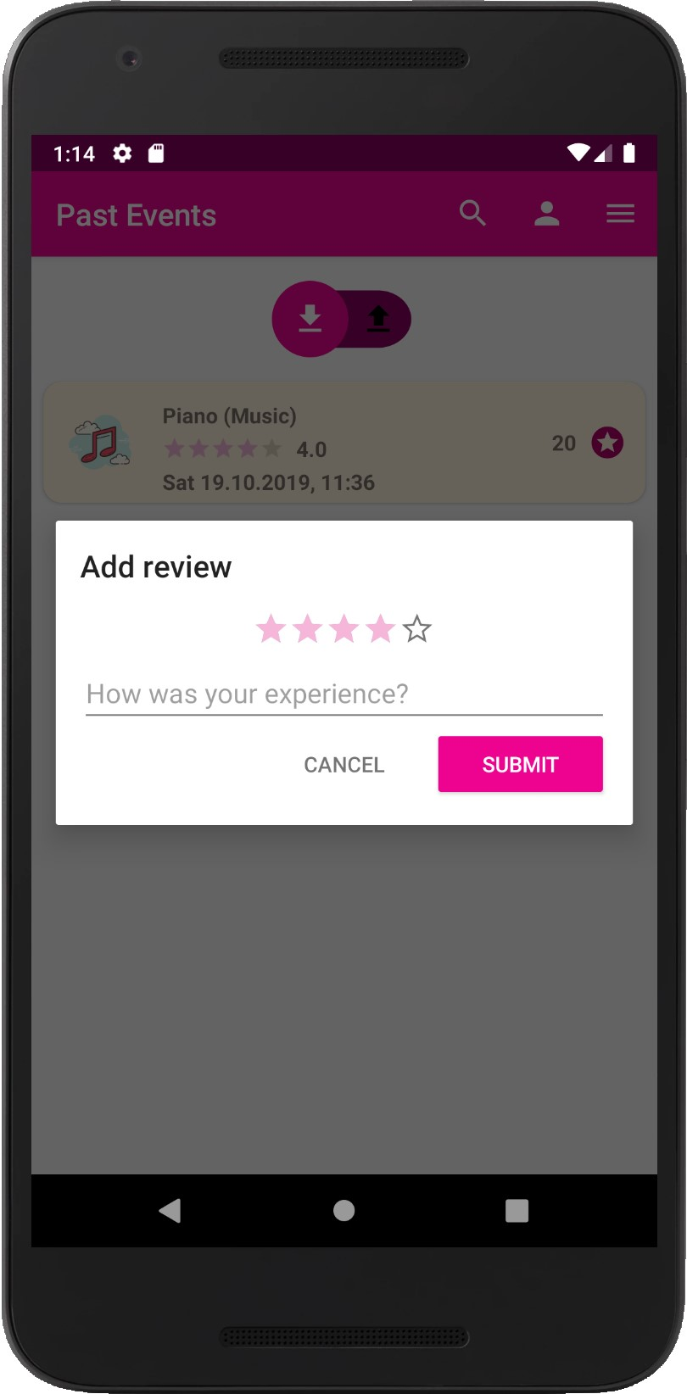
Features
History
View past appointments
Rate received service
Notes:
Easy authentication integrating Facebook, Google, Tweeter accounts
Allow sign-up for Technion students only (by Technion e-mail verification)
Each user can constantly change and modify services offered by him and his interests
Set the location of offered services
Set for each service offered the amount of requested points per service unit
Advanced search with filters:
By field / location (static or dynamic) / ranking etc
Ranking and dispute resolution system to increase users satisfaction
The ranking is mutual – both the user offering the service and the user receiving one
Instant messaging system – for secure and easy interaction between users

Slide 21
Features - Summary
Authentication
Registration
Edit profile data
Upcoming Events
Manage Skills
Manage Available Dates
Search Engine
History
Rankings
Notes:
Easy authentication integrating Facebook, Google, Tweeter accounts
Allow sign-up for Technion students only (by Technion e-mail verification)
Each user can constantly change and modify services offered by him and his interests
Set the location of offered services
Set for each service offered the amount of requested points per service unit
Advanced search with filters:
By field / location (static or dynamic) / ranking etc
Ranking and dispute resolution system to increase users satisfaction
The ranking is mutual – both the user offering the service and the user receiving one
Instant messaging system – for secure and easy interaction between users

Slide 22
Future Work
In-app communication between users
Sync with google calendar
Allow cancellations
Dispute resolution
Administrator interface
Addition of new skill by user
Per user’s skill rankings
Notes:
Easy authentication integrating Facebook, Google, Tweeter accounts
Allow sign-up for Technion students only (by Technion e-mail verification)
Each user can constantly change and modify services offered by him and his interests
Set the location of offered services
Set for each service offered the amount of requested points per service unit
Advanced search with filters:
By field / location (static or dynamic) / ranking etc
Ranking and dispute resolution system to increase users satisfaction
The ranking is mutual – both the user offering the service and the user receiving one
Instant messaging system – for secure and easy interaction between users

Slide 23

Thank You
Questions?

